Slide 1



Vietnam - Korea University of Information and Communication Technology
Faculty of Computer Engineering and Electronics
SPECIALIZED PROJECTS 2
BUILD AND IMPLEMENT A QR CODE SCANNING SYSTEM TO CHECK PRODUCT INFORMATION BY ESP32-CAM MODULE
Instructor : Dr. NGUYEN VU ANH QUANG
Performer : TRAN VIET AN
DaNang, May 2023

Slide 2
Vietnam - Korea University of Information and Communication Technology
Faculty of Computer Engineering and Electronics
01
02
Overview Introduction
Theory
System Model
Contents
03
04
Implementation
Result, Development
Author: Tran Viet An

Slide 3

Vietnam - Korea University of Information and Communication Technology
Faculty of Computer Engineering and Electronics
01
OVERVIEW INTRODUCTION
Author: Tran Viet An

Slide 4


01. OVERVIEW
Reason:
Commonly used
Encrypt and store a lot of data
Target:
Consolidate knowledge
Build an overview model
Apply into reality
Implementation content:
System model design
Design and build apps
Embedded programming and application programming
PCB Design 1 layer
Test, evaluate
Author: Tran Viet An

Slide 5

Vietnam - Korea University of Information and Communication Technology
Faculty of Computer Engineering and Electronics
02
THEORY AND SYSTEM MODEL
Author: Tran Viet An

Slide 6

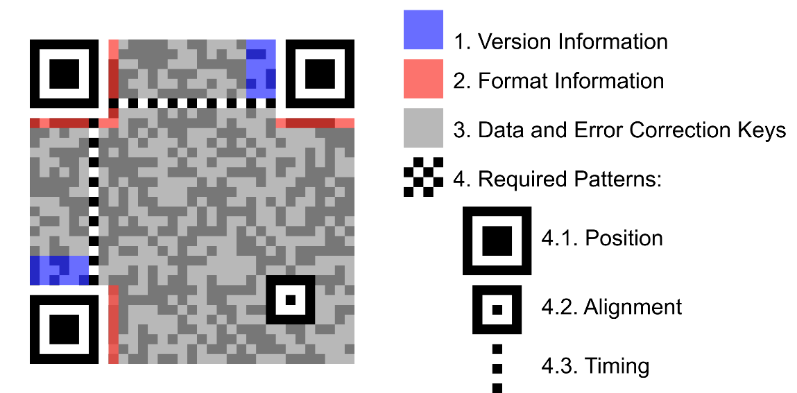
02. THEORY AND SYSTEM MODEL
QR code structure
QR – Quick Response
Two-dimensional barcode
Great encryption capabilities
7089 numbers/ 4296 alphabet,
special characters, link URL
Outstanding advantages:
Large volume of encrypted data.
Simple code scan.
The size of the QR code can be customized
Can easily create code
Author: Tran Viet An

Slide 7
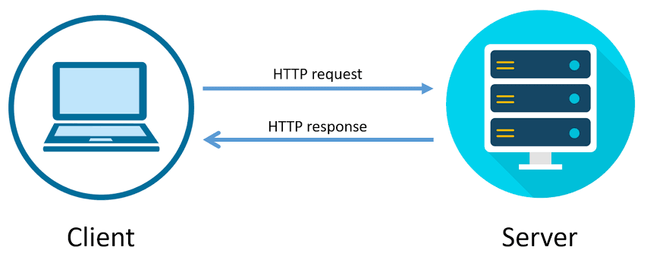

02. THEORY AND SYSTEM MODEL
A high-level, interpreted...
Easy to learn, powerful and flexible
Application programming, interface,...
Use pyzbar library: read barcodes through images
Web Server is a place to store, process and deliver Client web pages
HTTP - Hyper Text Transfer Protocol.
Client sends request to Server, server sends response back
Author: Tran Viet An

Slide 8
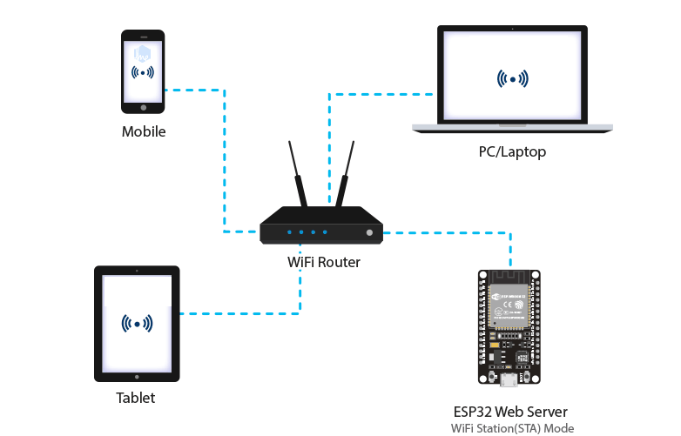
02. THEORY AND SYSTEM MODEL
ESP32 Web Server Operation Model in STA Mode
Author: Tran Viet An

Slide 9
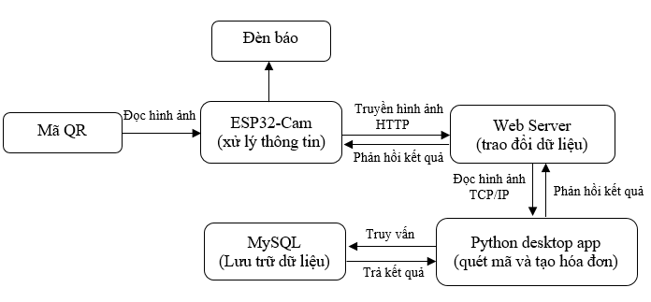
02. THEORY AND SYSTEM MODEL
Block diagram of the system
Author: Tran Viet An

Slide 10
02. THEORY AND SYSTEM MODEL
Block diagram of the system
Author: Tran Viet An

Slide 11

Vietnam - Korea University of Information and Communication Technology
Faculty of Computer Engineering and Electronics
03
IMPLEMENTATION
Author: Tran Viet An

Slide 12
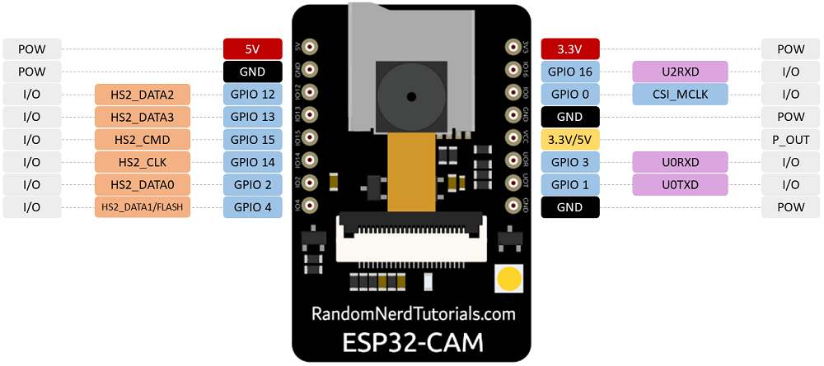
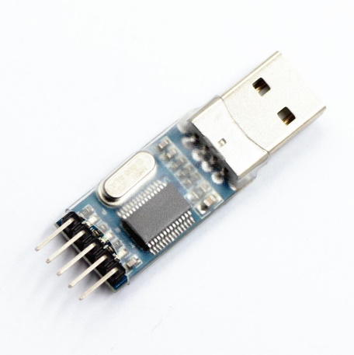
3.1 HARDWARE
Module ESP32Cam
USB to COM TTL UART
Author: Tran Viet An

Slide 13



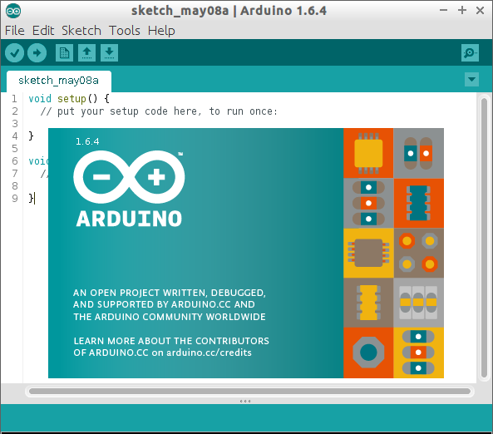


3.2 SOFTWARE
MySql
Altium Designer
XAMPP
Arduino IDE
Visual Studio Code
QT Design
Author: Tran Viet An

Slide 14
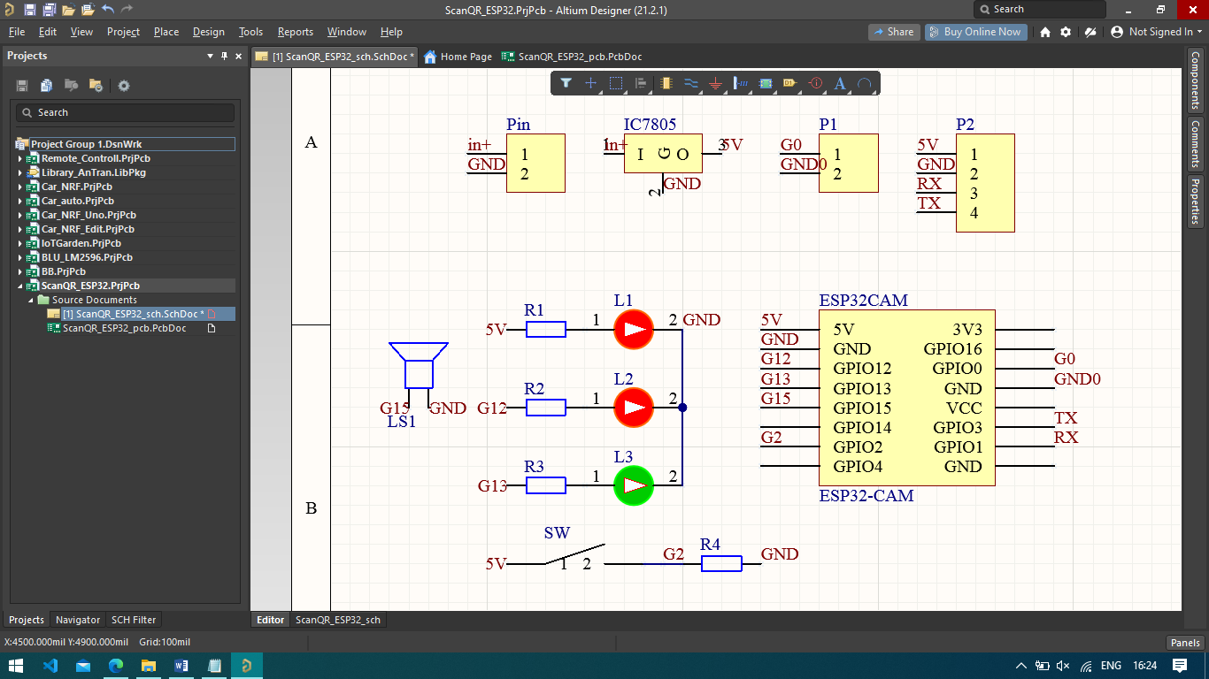
3.3 PRINCIPLE DIAGRAM
Schematic diagram
Author: Tran Viet An

Slide 15
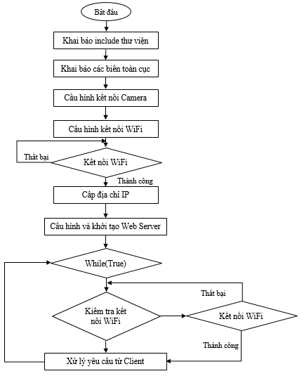
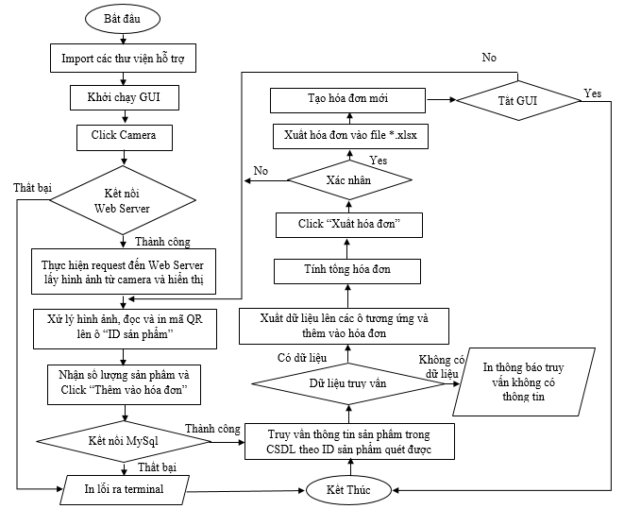
3.4 ALGORITHM FLOWCHART
Processing on ESP32Cam
Desktop Application
Author: Tran Viet An

Slide 16
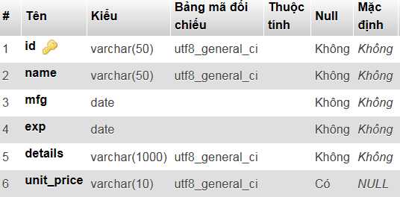
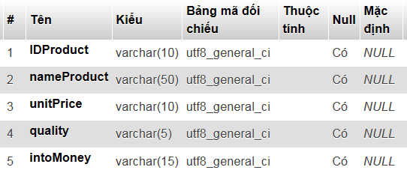
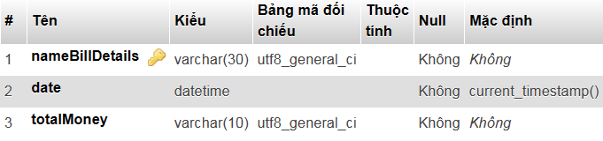
3.5 DATABASE TABLES
Products table
Detailed invoice table
Bills table
Author: Tran Viet An

Slide 17

Vietnam - Korea University of Information and Communication Technology
Faculty of Computer Engineering and Electronics
04
RESULT, DEVELOPMENT
Author: Tran Viet An

Slide 18
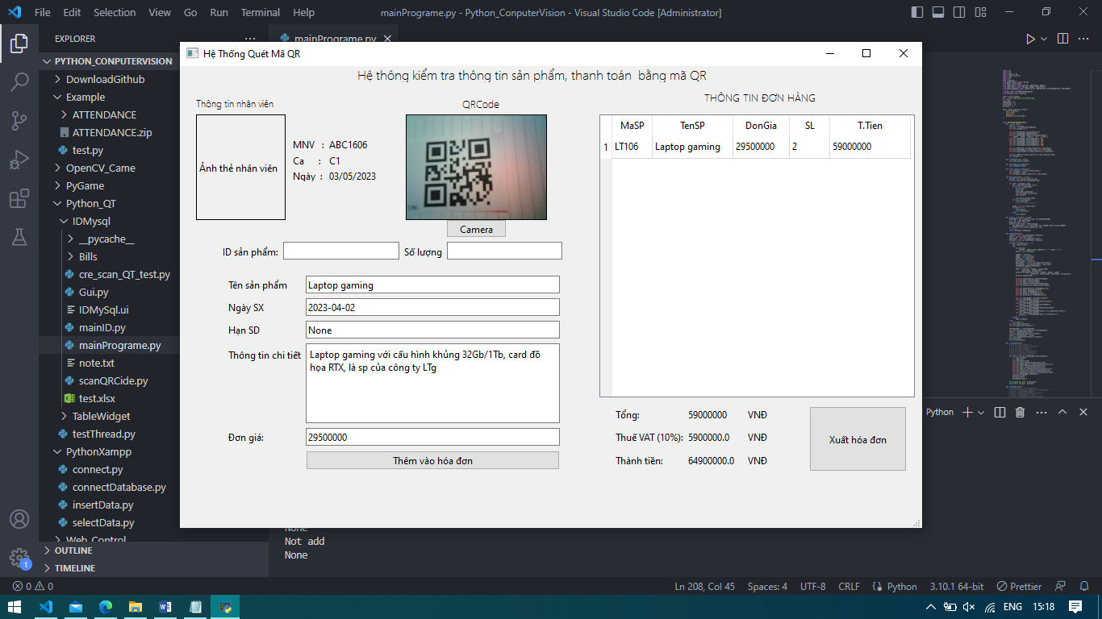
4.1 APPLICATION DESKTOP
Author: Tran Viet An

Slide 19
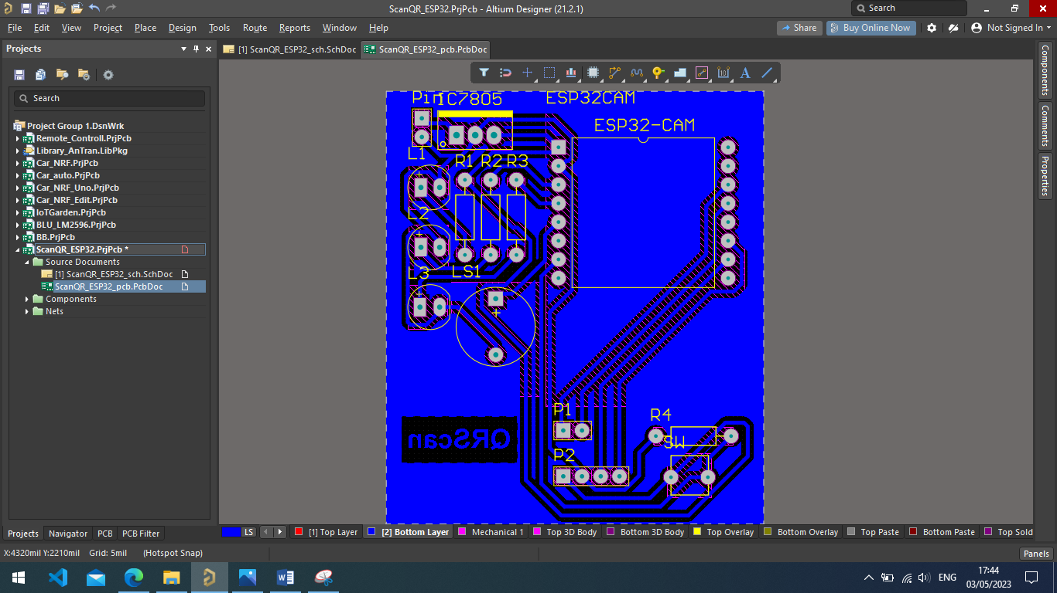
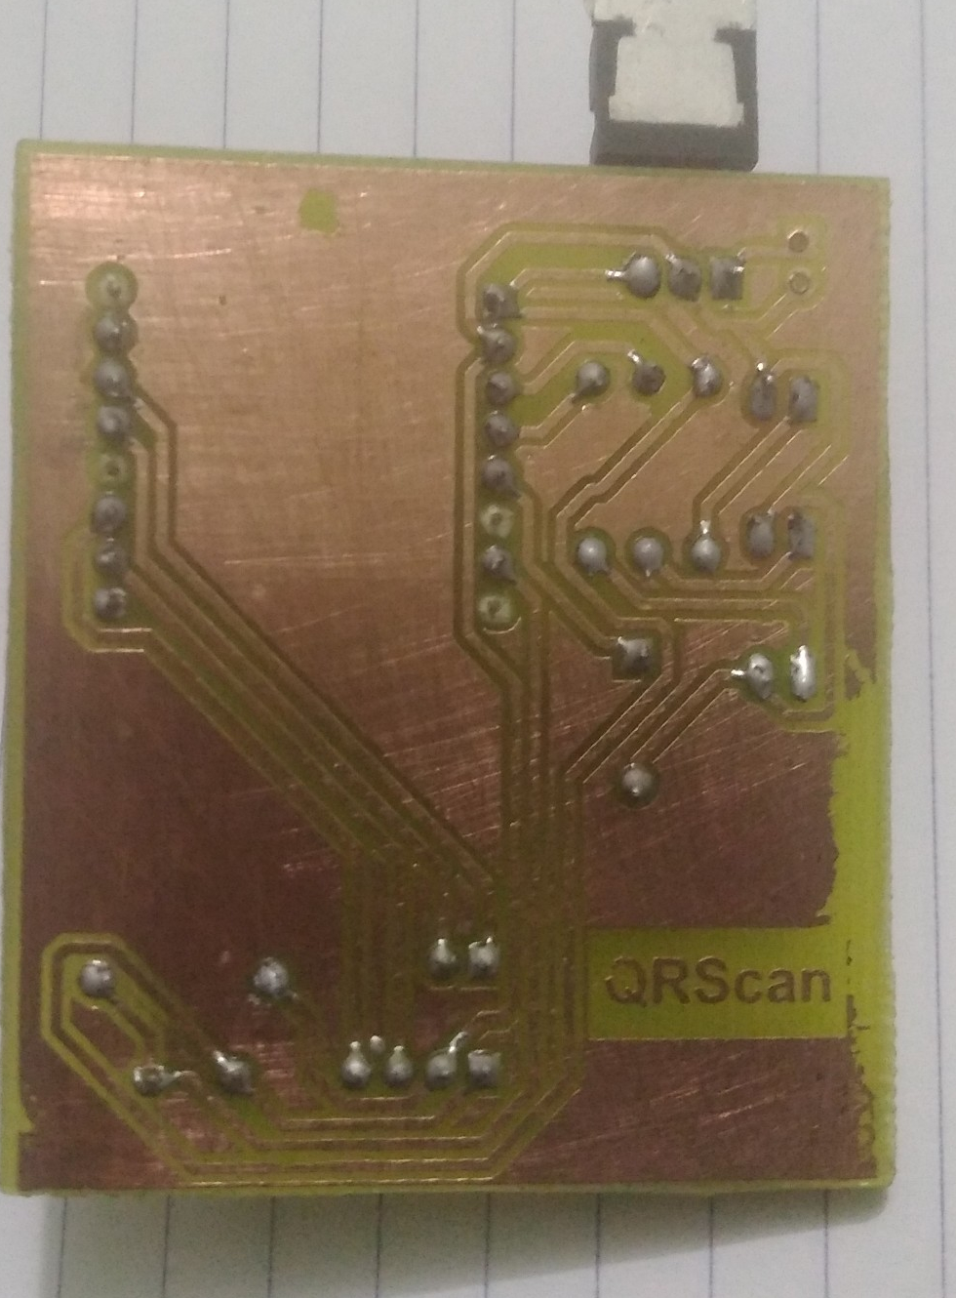
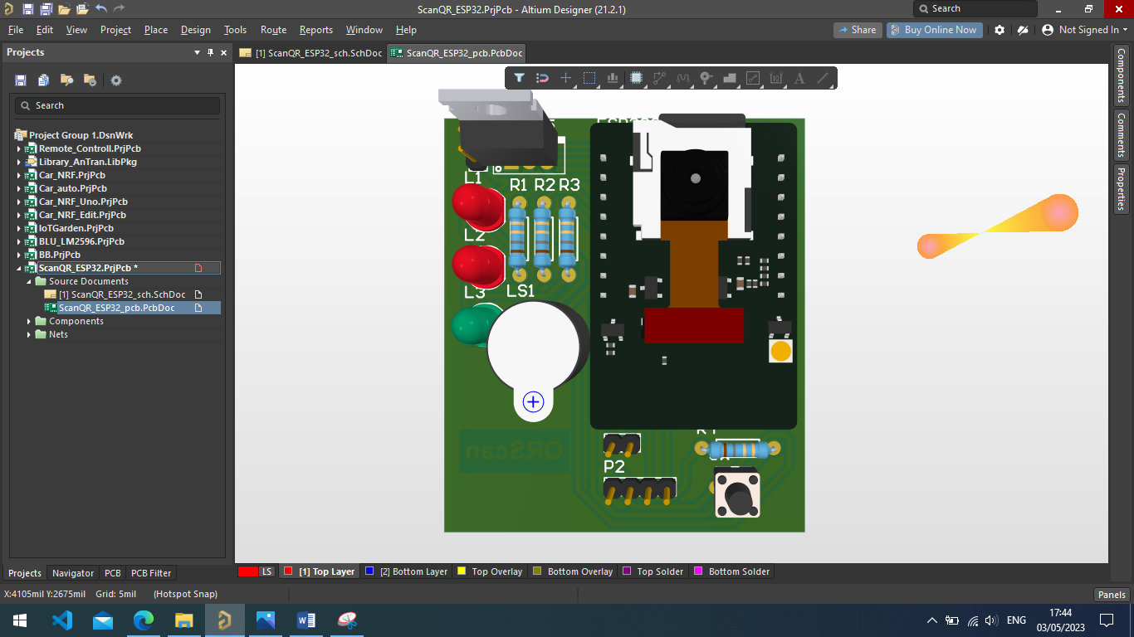
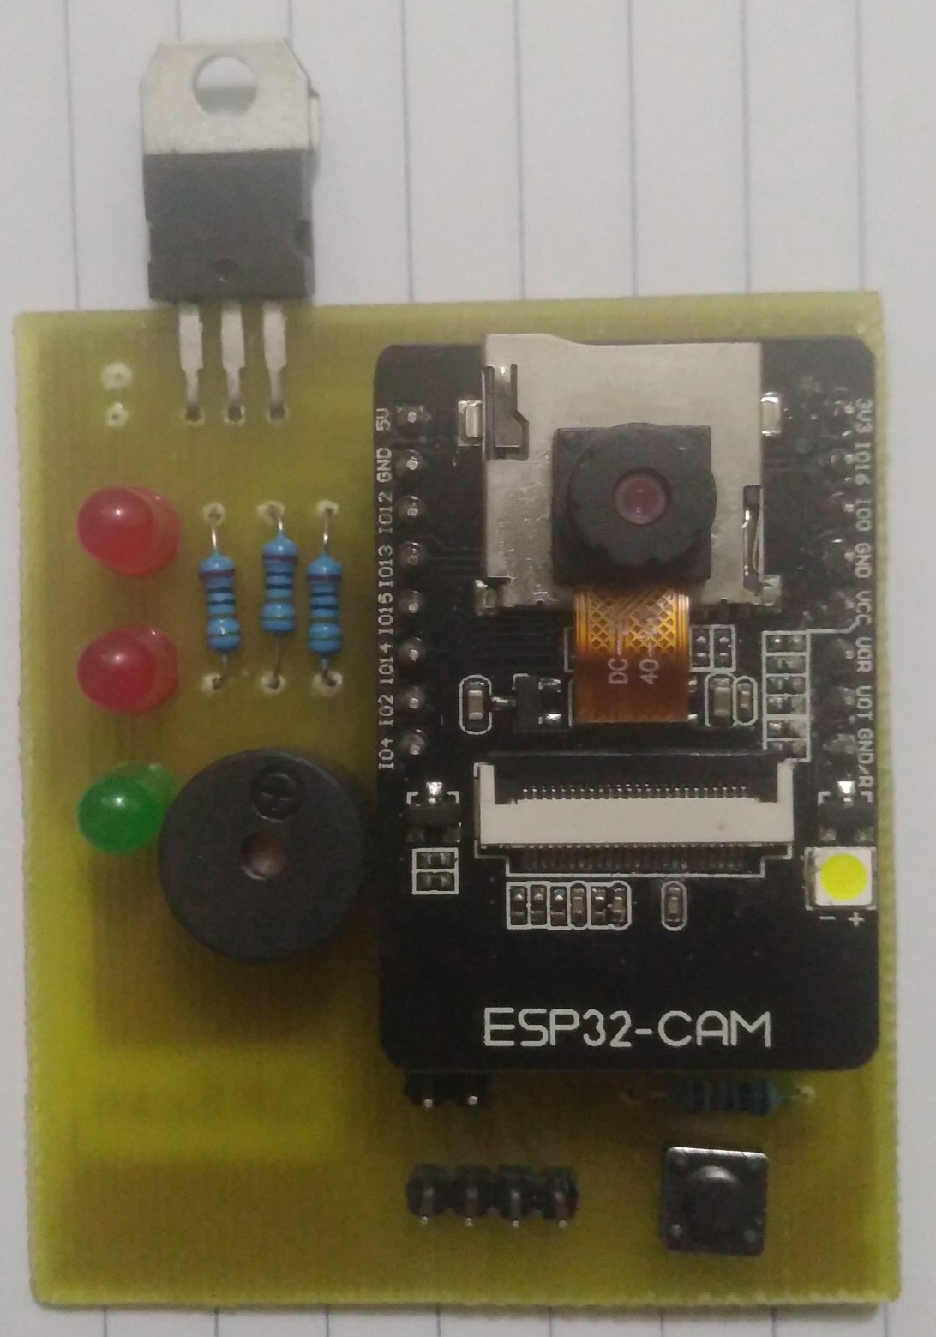
4.2 PCB CIRCUIT AND FINISHED PRODUCT
Author: Tran Viet An

Slide 20
CONCLUSION
Result
Limit
Development
Understand more theory
Build a system model
Finished product
Desktop application in python
Stable image transmission via WS
Connect and store to MySql
PCB circuit design and process
Function not completed
Processing speed is still slow
The transmission capacity is limited
The database is simple
practical application
Applying new techniques
Create the right database
Speed up processing and recognition
Create cross-platform, multi-system applications.
Author: Tran Viet An

Slide 21
Thank You For Your Listening
Author: Tran Viet An

